Slide 1
Intermediate Alexa Development with C#
More than Hello world with alexa
John Iwasz
john@whetstonetechnologies.io
@JohnI73

Slide 2
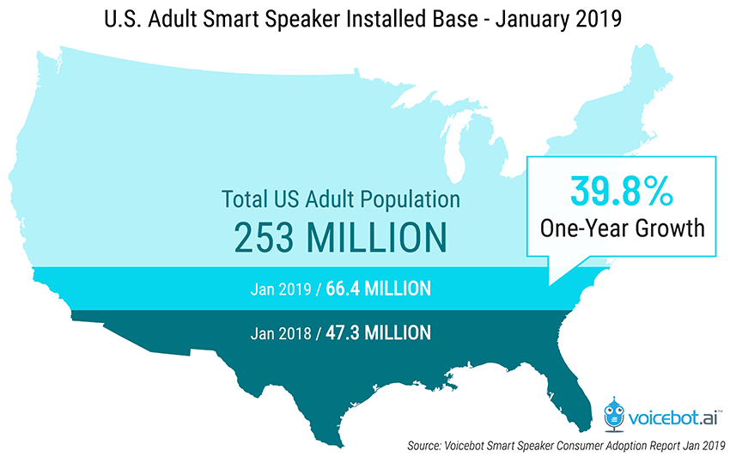
Voice Technology – US Growth 1/2018 – 1/2019

Slide 3
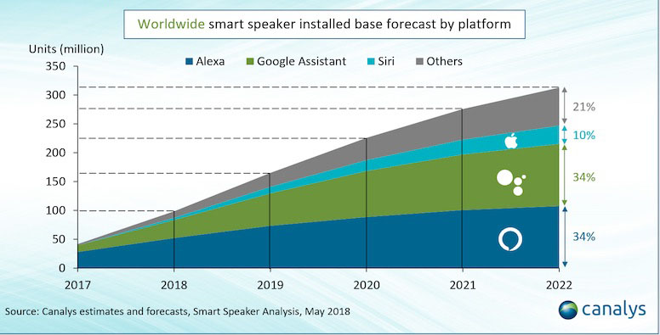
Voice Technology – Worldwide Growth

Slide 4
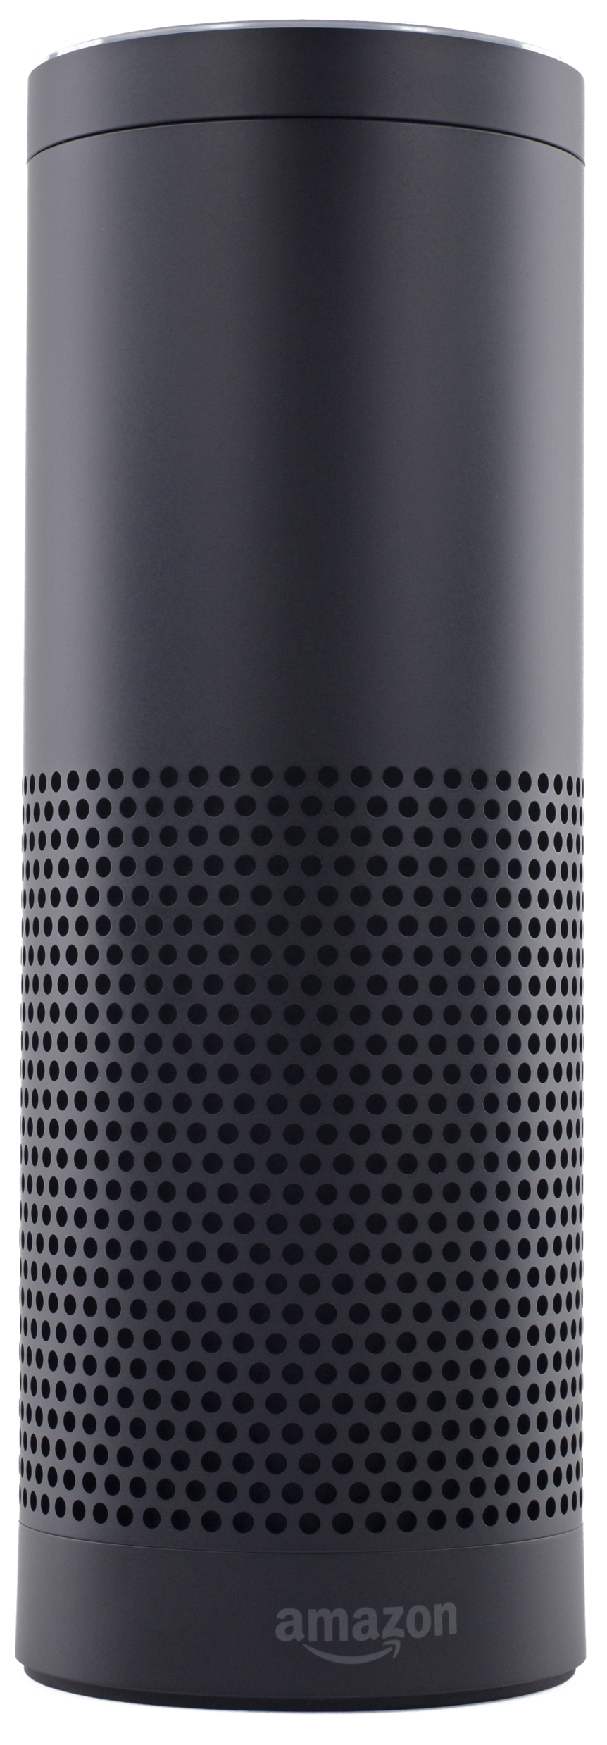



Voice Skills From Whetstone Technologies

Slide 5
Voice UX – Components of a Voice Application
REST Endpoint
Your skill – this is what processes the requests and responses
Intents
What the user says
These are your requests
Responses
What the assistant says – can use its voice or MP3’s
Includes reprompts
Visual Components – Cards, APL, Video, etc.

Slide 6
Voice UX - SSML
XML for speech <speech>Hello world!</speech>
phoneme
An orange <phoneme alphabet="ipa" ph="paʊw.">paw</phoneme> reaches out
say-as
<say-as interpret-as=“interjection”>yowzer</say-as>!
prosody
<prosody volume="x-loud">No way! </prosody>

Slide 7
Voice UX – Audio tag
Sound Library
<audio src='soundbank://soundlibrary/animals/amzn_sfx_bear_groan_roar_01’/>
Custom Audio File
<audio src=https://myserver/sounds/soundfile.mp3’/>

Slide 8
Voice UX – MP3 Specifications
The audio file cannot be longer than 240 seconds.
The bit rate must be 48 kbps. Note that this bit rate gives a good result when used with spoken content, but is generally not a high enough quality for music.
The sample rate must be 22050Hz, 24000Hz, or 16000Hz.
https://www.jovo.tech/audio-converter

Slide 9
Voice UX – MP3 Loudness
Loudness
Loudness Units relative to full scale (LUFS)
Guidelines
Program loudness for Alexa should average -14 dB LUFS/LKFS.
The true-peak value should not exceed -2 dBFS
Your skill may be rejected if
Is lower than -19 dB LUFS
Is higher than -9dB LUFS
Exceeds true-peak guidelines

Slide 10

Voice UX - Voices
Using Alexa’s Voice
Using Polly and Human Voices
Using All Human Voices

Slide 11
Voice UX & Context – A Point and Click Puzzle
The scene
Milfred the cat will give you a stinky mackerel in exchange for some catnip
The problems:
You can’t point and click and you can’t scroll up to see what you did (DOH!)
You have to manage state (context) of not having the tool and having the tool
Notes:
The scene:
Milfred – the cat will give you a stinky mackerel in exchange for some catnip
The catnip is in a field, but if you go into the field two crows relieve themselves on you
There’s a tool you need to get which you can use to scare off the crows so you can get the catnip
The problems
You can’t point and click and you can’t scroll up to see what you did (DOH!)
Always made sure the user knew the commands and prompts
Once the user got into an untenable state, put them on rails so they can solve without a map
After the crows do their business, tell the user to say “Go Back” to return to the barn
You have to manage state (context) of not having the tool and having the tool
Output story should be different based off of the state
For example, if you have the tool, you suddenly have the option to use it.
Vice versa, if you don’t have the tool and give the command to use it, that should choke

Slide 12
Voice UX & Context – Whetstone Technologies
Do they want to learn about Whetstone or VoiceConnectr?
Once they listen to one, send them to the next
Once they’ve heard both, get them contact information

Slide 13
Voice UX – Keep It Simple
Keep the choices to a minimum
3 seems to be the max
Be prepared for them to say other stuff
In Whetstone skill, if I just asked them if they want to contact us, they could still say “learn about Whetstone”
Graceful FallbackIntent Handling
If you get a Fallback intent, say something like ”I didn’t get that”, but keep the prompt suggestions Context Aware

Slide 14
Intents, Utterances, Slots, and Invocation Names
Intents communicate=user command
Examples: YesIntent, NoIntent, TravelToCityIntent
Utterances are words and phrases the user can say that map to an intent.
Example: “yes”, “okay”, “go ahead” map to a YesIntent
Slots are variables included in an utterance
Example: “I want to go to [US_CITY]”
Invocation Names are the launch name for your Skill
Alexa, launch “Animal Farm PI”

Slide 15
Alexa Messaging Format Overview
AlexaRequest includes
Identifiers: ApplicationId, UserId, SessionId
Alexa Request sends:
Spoken Response – text or Speech Synthesis Markup Language
Optional Card Response
Optional Reprompt

Slide 16

SSML Samples
Use Prosody to control volume and rate
Phonemes can override pronunciation
Can reference MP3 files and change voices
I can speak with my normal pitch,<prosody pitch="x-high" rate="fast"> but also with a much higher pitch and faster</prosody>, and also <prosody pitch="low" rate="x-slow">with a lower pitch and slowly.</prosody>.
<prosody volume="+4.08dB">
An <phoneme alphabet="x-sampa" ph='"Ig.glls'>Eagles</phoneme> win would have been <phoneme alphabet="x-sampa" ph="nois">nice</phoneme>.
</prosody>
<audio src="https://devstoryenginemedia.blob.core.windows.net/storymedia/adventuresample/audio/trollgrowl.mp3"/>
<voice name="Emma\">There's a troll in your way.</voice>

Slide 17
Alexa Skill Hosting Options - Lambda

Slide 18
Alexa Skill Hosting Options – Web API

Slide 19
Hosting Option Breakdown
Lambda
Deployed in AWS
Built-in version management
Cannot debug deployed lambda
Web API
Web APIs can be hosted in your own environment
Version management is up to developer
Easy to debug
Additional security requirements

Slide 20
Use Both!
Place any meaningful logic in a common assembly
Create a Web API or Azure Function project for debugging
Create a Lamba project for production deployment
Use dependency injection and IoC to abstract configuration
Use ngrok to expose a public API
http://bit.ly/alexangrok

Slide 21
Apply Dependency Injection in Web API
public class Startup
{
public Startup(IConfiguration configuration)
{
Configuration = configuration;
}
public IConfiguration Configuration { get; }
// This method gets called by the runtime. Use this method to add services to the container.
public void ConfigureServices(IServiceCollection services)
{
services.AddMvc().SetCompatibilityVersion(CompatibilityVersion.Latest);
services.AddAdventureSampleServices(Configuration);
}

Slide 22
Apply Dependency Injection in the Lambda
private static readonly Lazy<IServiceProvider> _serviceProvider = new Lazy<IServiceProvider>(() =>
{
var builder = new ConfigurationBuilder()
.AddEnvironmentVariables();
IConfiguration config = builder.Build();
IServiceCollection servCol = new ServiceCollection();
servCol.AddAdventureSampleServices(config, HostTypeEnum.Aws);
return servCol.BuildServiceProvider();
});
. . .
; public async Task<AlexaResponse> FunctionHandlerAsync(AlexaRequest req, ILambdaContext context)
{
IServiceProvider curProvider = _serviceProvider.Value;

Slide 23
Add Dependency Injection in AWS Serverless Function
private static readonly Lazy<IServiceProvider> _serviceProvider = new Lazy<IServiceProvider>(() =>
{
var builder = new ConfigurationBuilder()
.AddEnvironmentVariables();
IConfiguration config = builder.Build();
IServiceCollection servCol = new ServiceCollection();
servCol.AddAdventureSampleServices(config, HostTypeEnum.Azure);
return servCol.BuildServiceProvider();
});
. . .
[FunctionName("AlexaFunction")]
public static async Task<IActionResult> Run(
[HttpTrigger(AuthorizationLevel.Function, "get", "post", Route = null)] HttpRequest req,
ILogger log)
{
. . .
IServiceProvider servProv = _serviceProvider.Value;
IAlexaRequestVerifier alexaVerifier = servProv.GetRequiredService<IAlexaRequestVerifier>();

Slide 24
nGrok Debugging Demo Debugging Article: http://bit.ly/alexangrok Dependency Injection: http://bit.ly/azfuncdi

Slide 25
Image media storage requirements
All files provided on TLS-secured URLs
Images must be provided on static URLs
smallImageUrl - 720w x 480h – displayed on mobile app
largeImageUrl - 1200w x 800h – displayed in large devices (e.g. Echo Show)
JPG or PNG – no animated GIFs
500 Kb or less
MP3 cannot be more than 240 secs
MP3 Audio converter: jovo
Amazon has an audio library

Slide 26
CORS Configuration Host
<?xml version="1.0" encoding="UTF-8"?>
<CORSConfiguration xmlns="http://s3.amazonaws.com/doc/2006-03-01/">
<CORSRule> <AllowedOrigin>http://ask-ifr-download.s3.amazonaws.com</AllowedOrigin> <AllowedMethod>GET</AllowedMethod> </CORSRule>
<CORSRule> <AllowedOrigin>https://ask-ifr-download.s3.amazonaws.com</AllowedOrigin> <AllowedMethod>GET</AllowedMethod> </CORSRule>
</CORSConfiguration>

Slide 27
Session state storage options
Serialize to session attributes
No Cloud storage required
Limited to session
Server storage
DynamoDb and S3 are the cheapest options on AWS
Azure Table Storage or Azure Blob storage

Slide 28
Session State Demo

Slide 29
Using Alexa Interface Templates
CanFulfillIntentRequest – Supports nameless invocation. Voice SEO.
Audio Player– Playing longform audio (podcasts, music, etc.)
Video Player – For use with Echo Show and Fire TV
Display Interface – Echo Show Templates
Alexa Presentation Language – Rich replacement for Echo Show Templates
Skill Notification – Hidden from Skill console

Slide 30
Skill Activation Notification Demo

Slide 31
Requesting Permissions
Skills can request the following information from an Alexa account:
Email
Full Name
Given Name (i.e. first name)
Device Address
List Permission rights
Permissions must be requested with a card response
User must interact with mobile app or alexa.amazon.com to grant permission

Slide 32
Permissions Demo

Slide 33
Voice UX Design Tips
Keep responses under 90 seconds
Can use voices other than Alexa with Polly
good for games
not recommended for business applications
Use Reprompts to guide users’ decisions
For business and utility apps, keep the interaction short and meaningful
Use intermediate response to tell user Skill is working during a long-running process

Slide 34
Intermediate Response Demo

Slide 35
Github Repositories
https://github.com/WhetstoneTechnologies/Whetstone.Alexa
https://github.com/WhetstoneTechnologies/Whetstone.Alexa.AdventureSample
https://github.com/WhetstoneTechnologies/Whetstone.Alexa.EmailChecker

